Slide 1

MicroCore Labs Emulators
How they work
How to build one
Crawford Griffith
VCF Forum ID (Crawford)

Slide 2
What We’ll Cover
Who I am, Who Ted Fried is, What MicroCore Labs is
What the plug-in emulators are / aren’t
Detailed design review of Hardware and Software
Build information, and gotchas
Success story for debugging a vintage system
Ideas for what you can do with these things
More info – Links, contact info, stuff
Thanks

Slide 3
Who I am, Who Ted Fried is, What MicroCore Labs is
Me – VCF Member, into DEC, OSI, Making things
Ted Fried – Embedded hardware engineer and vintage computer enthusiast with and interest in microprocessors
MicroCore Labs - Blog - http://www.microcorelabs.com/home.html
Github - https://github.com/MicroCoreLabs/Projects
VCF Forum ID – MicroCoreLabs
Youtube - https://www.youtube.com/@microcorelabs7698/featured
→ Ask questions, this is a talk not a lecture!←

Slide 4
Who I am, Who Ted Fried is, What MicroCore Labs is
MicroCore Labs is the collection of Ted Fried’s websites
Ted builds plug-in emulators, both FPGA* and microprocessor based
All Open Source, All design and code published
This talk - only about the microprocessor-based ones
* Field-Programmable Gate Arrays

Slide 5
What the plug-in emulators are / aren’t
Definitions
"Emulators" -
Pure software emulators - All software running on something fast
Hardware based - Hardware or Hardware + Software inside a host (vintage) computer
"Cycle-accurate"
Virtually identical operation and speed as the original CPU, but not “cycle-exact”
"Plug-in emulators"
Replaces a CPU inside a system
Also known as In Circuit Emulator (ICE) - make Vanilla joke here

Slide 6
What the plug-in emulators are / aren’t
MicroCore Labs Plug-In Cycle-Accurate Emulators
Naming "MCLxx" and "MCLxx+" – In General, the "+" ones are microprocessor-based
List of MCLxx[+] emulators
MCL65+ - 6502 *
MCL64 - 6510 (Commodore)
MCLZ8 - Z80 *
MCL86+ - 8088 *
MCL68+ - 68000
* I have personally built and tested these

Slide 7
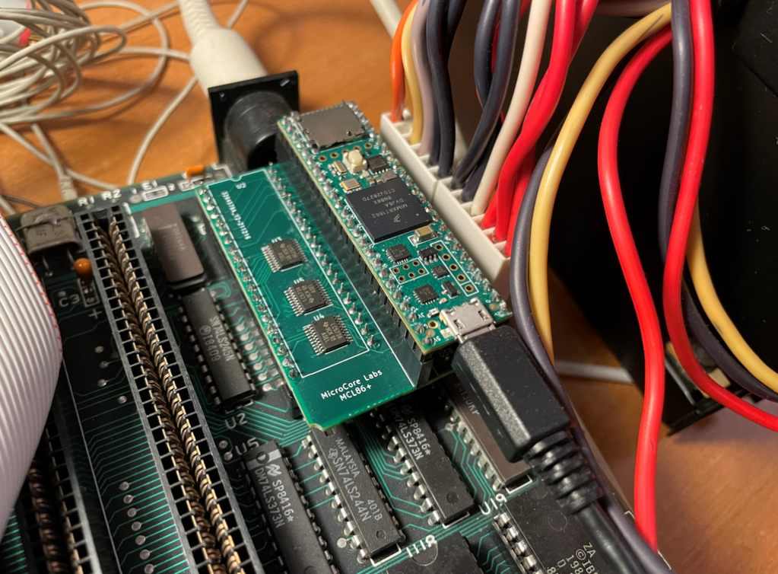
What the plug-in emulators are / aren’t
Here’s what one looks like in a vintage machine (MCL86+ in an IBM PC 5150)

Slide 8
What the plug-in emulators are / aren’t
Why are these things useful?
Can help debug a machine
Can help bring up a machine w/o some things (boot ROM, disk, serial, I/O, video)
Can emulate part of the system
But, also to have fun! Do wild stuff like acceleration, Frankenstein brain swaps, etc.
Extend/upgrade a vintage machine (discussed later)

Slide 9
Detailed design review of Hardware and Software
IN
- Configuration
- Volts
- Interrupts
- Clock
- Command signals
(Wait, etc.)
OUT
- Read / Write
- Other Command signals
Very Generic CPU
IN/OUT
- Data
- Peripheral signals

Slide 10
Detailed design review of Hardware and Software
Considerations:
Need something faster than the original CPU – Generally WAY faster
Need something with a lot of memory (RAM, Flash)
Need enough Input/Output lines to drive the CPU signals

Slide 11
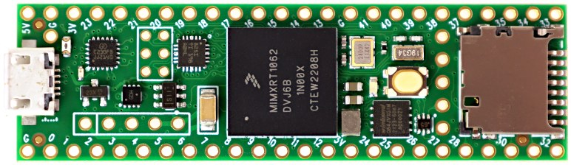
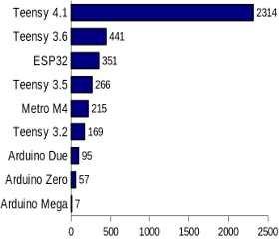
Detailed design review of Hardware and Software PJRC’s Teensy 4.1
ARM Cortex-M7 at 600 MHz
Float point math unit, 64 & 32 bits
7936K Flash, 1024K RAM (512K tightly coupled), 4K EEPROM (emulated)
QSPI memory expansion, locations for 2 extra RAM or Flash chips
USB device 480 Mbit/sec & USB host 480 Mbit/sec
55 digital input/output pins, 35 PWM output pins
18 analog input pins
8 serial, 3 SPI, 3 I2C ports
2 I2S/TDM and 1 S/PDIF digital audio port
3 CAN Bus (1 with CAN FD)
1 SDIO (4 bit) native SD Card port
Ethernet 10/100 Mbit with DP83825 PHY
32 general purpose DMA channels
Cryptographic Acceleration & Random Number Generator
RTC for date/time
Programmable FlexIO
Pixel Processing Pipeline
Peripheral cross triggering
Power On/Off management
CoreMark Benchmark

Slide 12
Detailed design review of Hardware and Software Teensy 4.1
Teensy 4.1 Summary:
- Really fast CPU, on-board overclocking up to 816 Mhz without cooling
- Lots (55 pins) of Input/Output lines (42 are used on most MCLxx[+] boards)
- Software (a biggie) - ARDUINO (C/C++)
LOL - Lots Of Libraries
- Cost is ~ $30 online and at MicroCenter stores
...but... Teensy is not 5V tolerant, it is a 3.3V board! (solved)

Slide 13
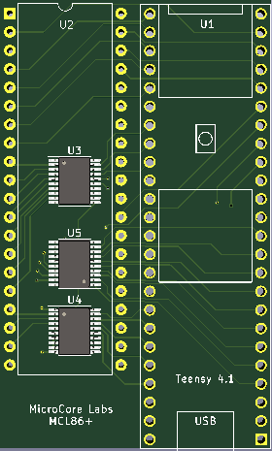
Detailed design review of Hardware and Software
Hardware – MCLxx[+] Boards
One Job – safely connect the Teensy 4.1 pins to the CPU Socket
Actual Boards (show some)
Fairly simple, 3-5 IC's, headers
buffers, latches mainly for 3.3V transition in and out of Teensy 4.1
Teensy on-board regulator takes in 5V and outputs 3.3V
Surface Mount Technology (scary!) - not really (discussed in the build section)

Slide 14
Detailed design review of Hardware and Software
Talk about that software – Relax, It’s all in one Arduino code file (MCLxx.INO)
Parts of the emulator code:
Setup - what Pins do what - In or Out
Main Loop - get an instruction
- decode it, execute it
- rinse and repeat (Lots of waiting for the next clock cycle)
Instruction Decode/Execute functions
- as many as it takes
Bunch of Arrays
- Some arrays are for ROM images
- Some arrays are for Pin value lookups (discussed next slide)
Bus Interface
- Memory and I/O
- Arbitration for what goes where host system vs Teensy

Slide 15
Detailed design review of Hardware and Software
Software – Secret Sauce for Speed
Teensy-specific Code
Fast I/O
- Standard Arduino library routines for GPIO* read and write are too slow
- Teensy allows direct access to GPIO registers
- “without the fast IO none of this would be possible.” – Ted Fried
Pin value lookup Arrays
- Pin values sent to GPIO registers (and then to CPU socket)
- Physical Pins are not always neatly laid out on target CPU or Teensy
- Either have to do bit manipulation (logical OR, shifts) or lookup arrays
- Array lookups are faster than inline math
- Only if you change a MCLxx[+] board layout should this concern you
* General Purpose Input Output

Slide 16
Detailed design review of Hardware and Software
Software Realities
- Have to install the Arduino IDE on a PC or Mac
- Have to install Teensyduino utility, from PJRC
- Have to set the Processor Speed in Arduino IDE menus*
- Have to set the Code Optimization level (hint – use Fastest)*
* Or use my forked code in github

Slide 17
Build information, and gotchas
MCLxx[+] Boards - Got to make some boards! (or more accurately, get them made - best to farm these out)
Overseas manufacturing (pluses and minuses)
JLCPCB and PCBWay are two companies that do this
Price-per-board is low ($25 or less for 5 boards)
Made very quickly (usually 48 hours or less)
Shipping is high (like $25) (or wait a few weeks)
You can get a solder paste stencil (if you're fancy)
Both JLCPCB and PCBWay can also assemble the SMT for you,
JLCPCB with their parts, and PCBWay with parts from Digikey, Mouser, etc.
Best to do a group buy, spread the cost

Slide 18
Build information, and gotchas
Build Section – Board Components
Bare Boards:
Get the IC's from anywhere (Mouser, Digikey, eBay)
They are TSSOP-20 (0.65mm pin spacing) exception: DIP packages for MCL65+
Remember to get 3.3V chips (5V tolerant), generally 74HC or 74LVC or 74AHC
All Boards:
Headers - get 40 pin Male-male machine pin for the plug into the CPU socket (PCB bottom)
- get 40 pin male and female "Arduino-like but longer“ (PCB top)
- Teensy 4.1 is 48 pins (24 to the side)

Slide 19
Build information, and gotchas
Build Section – As Easy as 1-2-3! - Soldering 1a
------------- OPTION A -----------------
Have the PCB shop assemble the SMT
Most have this service

Slide 20

Build information, and gotchas
Build Section – Soldering 1b – it’s not terribly hard
------------- OPTION B -----------------
Good soldering station, fine soldering tip, thin solder, solder wick and a MAGNIFYING GLASS
Surface Mount Technology (SMT) chips - YOICKS!
LOOK AT THE LAYOUT-HARD TO SEE THE PIN 1 INDICATION, THE CHIPS DO NOT ALL HAVE THE SAME ORIENTATION
Steady hands - these are TSSOP-20 0.65mm chips
Center the chips, solder pin 1, recenter and solder pin 11 (opposite corner)
LOOK AT THE PIN ONE INDICATORS, IT IS BETTER TO DESOLDER 2 PINS THAN 20! DO NOT ASK ME HOW I KNOW THIS!
Solder the rest of the pins

Slide 21
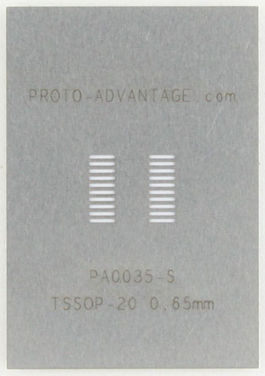
Build information, and gotchas
Build Section – Soldering 1c
-------------- OPTION C ---------------
Use the solder stencil
Apply solder paste with a credit card
Peel off the solder stencil carefully
Center the chips carefully on the solder
Pre-heat board on a hot plate
Hit it with the hot air station (heat high, air low so you don’t send chips airborne)
Watch with wonder as the chips magically move to the exact right place

Slide 22
Build information, and gotchas
Build Section – Soldering 2 – Teensy Headers
Inspect the SMT chip pins for bridges, use solder wick dipped in flux to fix
Install Teensy headers
Solder male "Arduino-like" headers to the underside of the Teensy 4.1 board (if not supplied)
Long "Arduino-like" female headers on top of the PCB, use the Teensy w/headers to hold them parallel
Push the header up from the underside, tack down the end pins
Check that the headers are tight to the board
Solder the other pins down

Slide 23
Build information, and gotchas
Build Section – Soldering 3 – CPU Headers
Install CPU headers
put the side of the header with thinner pins into a 40 pin socket
put the headers through the underside of the PCB
turn the board over holding the socket+headers tight to the underside of the board
solder the end pins (1, 20, 21, 40)
check the headers are tight to the board
solder the other pins down

Slide 24
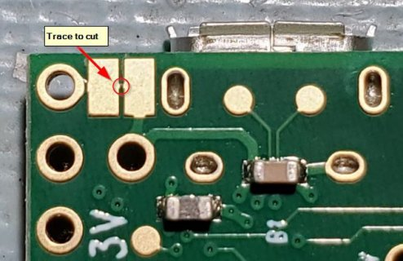
Build information, and gotchas
Build Section - final assembly
- Give the Teensy 4.1 some minor surgery (or delay this until you program the Teensy)
- Cut the pad near Vcc, so that the USB cable does not try to power the target system!
- Plug the Teensy 4.1 board into the header
(look at the outline and make sure the sd card holder and usb are lined up)

Slide 25
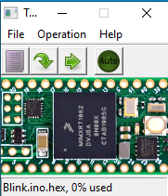
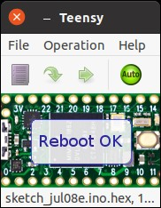
Build information, and gotchas
Build section - Software
Download the software for the board from Github (RAW Download)
Install the Arduino IDE or update yours to the latest, install Teensyduino from PJRC.com
Launch the Arduino IDE
Go to board manager and search for Teensy, load the library
Start a new project and navigate to the MCLxx.INO file and open it
Immediately set the board to Teensy 4.1
Set the Speed to 816Mhz
Set the Optimization to Fastest
Cross fingers
Plug in MCLxx[+] board into a power source if the Vcc pad was cut
Plug a USB micro cable into the Teensy (make sure it is not a charge-only cable)
Cross fingers and hit the compile/Verify button on the IDE
When the Teensy programmer pop-up shows, press the white button on the Teensy
Smile when the programmer reports the teensy is programmed and reset okay

Slide 26
Success Story for debugging a vintage machine
I have a Ohio Scientific Challenger 1P, with no serial port and a malfunctioning floppy disk drive
I had built a MCL65+ board, and tested it on a (loaned) Apple II+
David Gesswein has an excellent floppy disk program for OSI computers (Floppy test 1.04u.zip)
And I had no way to load it other than a somewhat flaky keyboard on the OSI C1P
So…
I converted David’s Floppy Test code in Hex to a C-code array using Notepad++
I pasted the array into the MCL65.INO file
I made a small patch in the MCL65+ code to load the array at address 0x0300
I plugged the MCL65+ into the Challenger 1P, hit reset, entered the monitor, hit 0300 G
And *BAM* there was the disk test program running on my C1P!
(Total elapsed time was ~1 hour)

Slide 27
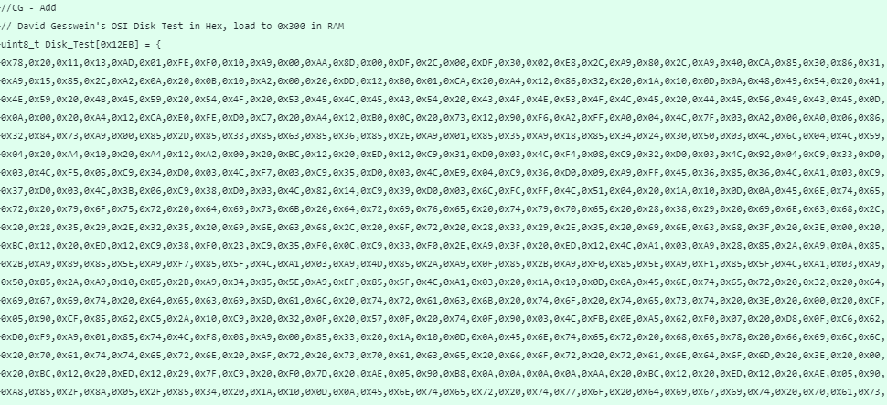
Success Story for debugging a vintage machine
The Code Array – Covers several screens

Slide 28
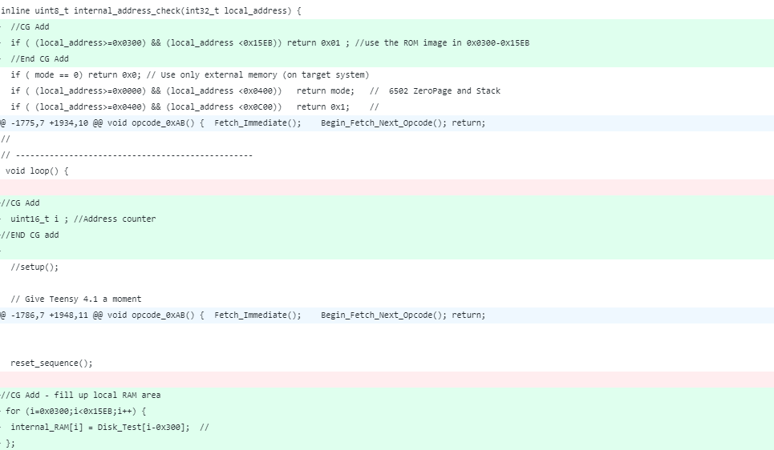
Success Story for debugging a vintage machine
The Logic – Tell the emulator to use internal RAM for 0x300-0x15EB, define a counter, put the array in internal RAM

Slide 29
Ideas for what you can do with these things
Accelerate your machine – Ted has already added this in most of the existing code
Write code [or port] a system test process in C and run it on the Teensy
-> there is already one done for the Commodore 64 !
Get a machine to boot that does not have some vital hardware, like tape (paper or plastic),
serial port, video out, keyboard, diskette or Hard disk
Easily mirror, or even increase system RAM size or try different ROM versions using emulated memory inside the Teensy
Expand a machine using the SD card or fast serial over USB - teensy as a USB host
Add networking with Ethernet (yeah, Teensy 4.1 has that too)
Emulate an extremely rare piece of hardware (like the OSI Hard disk)
Put a new (or expanded) instruction set into your computer (see the MicroCore Labs 68000 in an IBM PC)
Emulate another CPU : 65816, 6800, 6809, PDP-11, Harris 6120 ...

Slide 30
More info – Links, contact info, stuff
Crawford’s fork of MCL projects - Github.com/CrawfordGriffith
Amazon Link for Male-male machine pin headers (for CPU socket)
Amazon Link for 40-pin “Arduino-like” heaters (male and female)
PJRC Downloads

Slide 31
Thanks !!!!
You folks for coming to the talk!
Ted Fried for his AWESOME projects and help and feedback!
Jeff Brace and volunteers for putting on an (always) AWESOME Vintage Computer Festival East event!
David Gesswein for his Floppy Test program!
Alex Jacocks and Maki Kato for loaning me systems to test on!

